Slide 1
Digital Image Processing
Lecture 5:
Ch3:Image Enhancement in the Spatial Domain:
3:5 Basics of Spatial Filtering
3:6 Smoothing Spatial Filters
Dr. Hossam Mahmoud Moftah
Assistant professor – Faculty of computers and information –
Beni Suef University

Slide 2
Local Histogram Processing
Define a neighborhood and move its center from pixel to pixel
At each location, the histogram of the points in the neighborhood is computed. Either histogram equalization or histogram specification transformation function is obtained
Map the intensity of the pixel centered in the neighborhood
Move to the next location and repeat the procedure

Slide 3
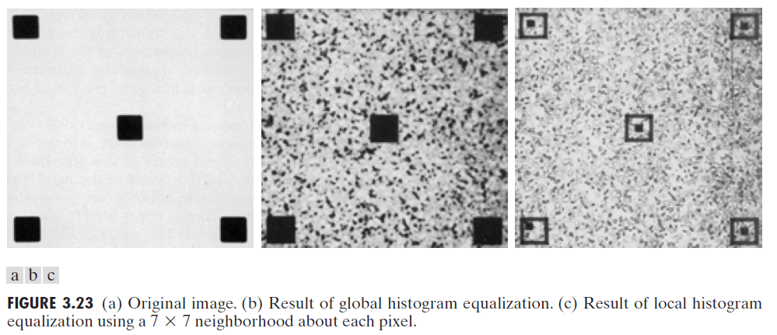
Local Histogram Processing: Example

Slide 4
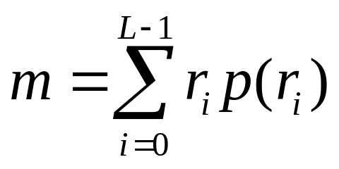
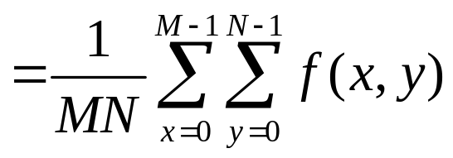
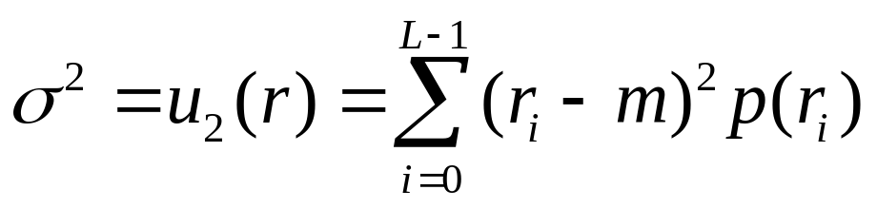
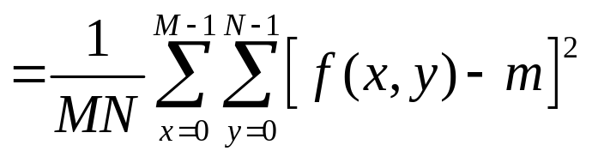
Using Histogram Statistics for Image Enhancement
Average Intensity
Variance

Slide 5
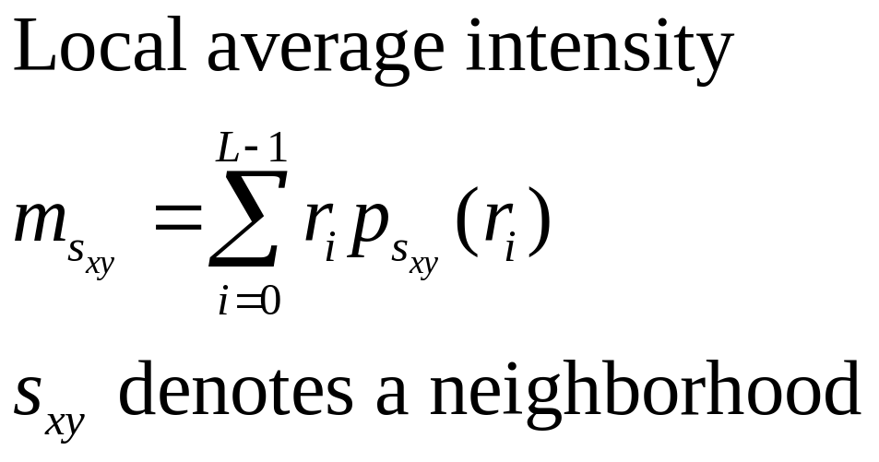
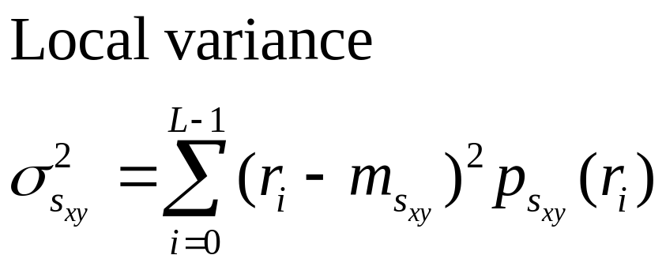
Using Histogram Statistics for Image Enhancement

Slide 6
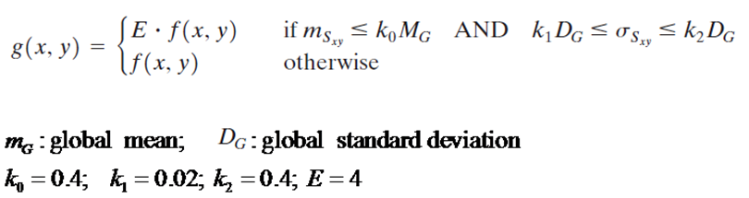
Using Histogram Statistics for Image Enhancement: example

Slide 7
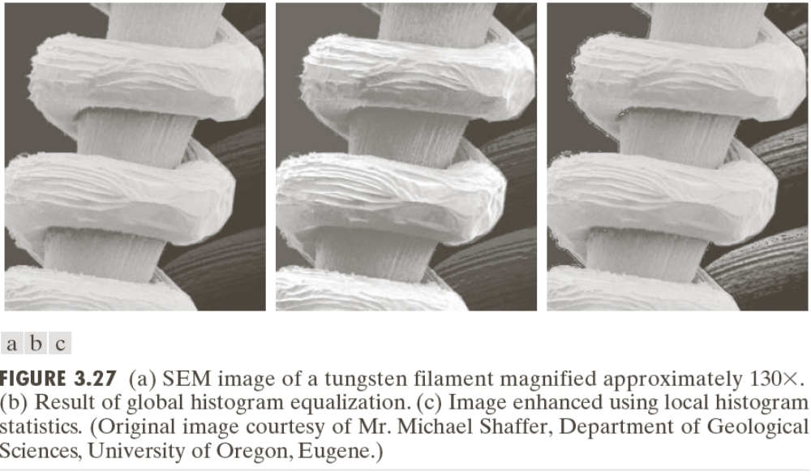
Using Histogram Statistics for Image Enhancement

Slide 8
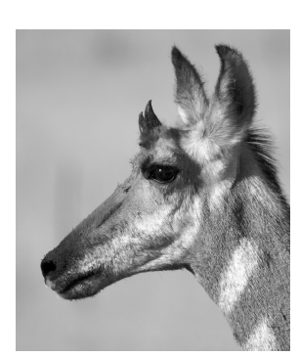
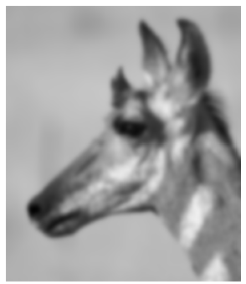

What Point Operations Can’t Do
Blurring/Smoothing

Slide 9
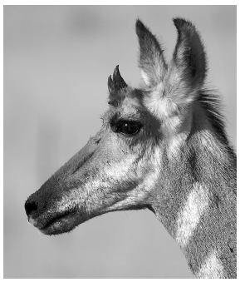
What Point Operations Can’t Do
Sharpening

Slide 10
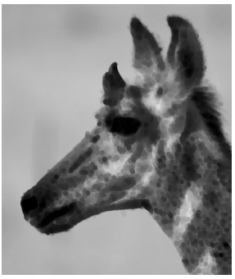
What Point Operations Can’t Do

Slide 11
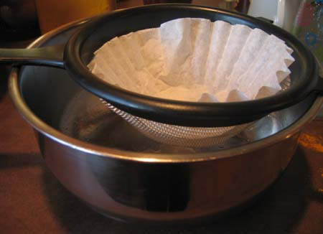
Image Filtering

Slide 12
Spatial Filtering
Neighborhood operations work with the values of the image pixels in the neighborhood and the corresponding values of a subimage that has the same dimensions as the neighborhood.
The subimage is called a filter, mask, kernel, template, or window. The values in a filter subimage are referred to as coefficients rather than pixels.

Slide 13
Spatial Filtering
These neighborhood operations consists of:
  Defining a center point, (x,y)
  2. Performing an operation that involves only the pixels in a predefined neighborhood about that center point.
  3. Letting the result of that operation be the “response” of the process at that point.
  4. Repeating the process for every point in the image.

Slide 14

What is filtering?
Input image f.
Resulting image g after transformation T, i.e.,
Transformation T is performed locally
Called filtering(from the field of signal processing)

Slide 15
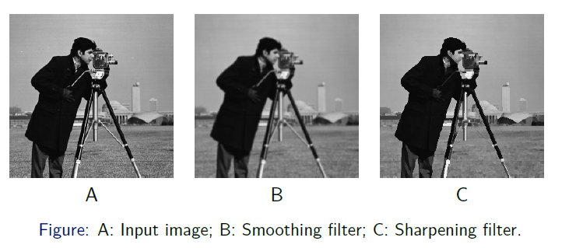
Spatial Filtering
Two goals
  Smoothing
  Sharpening

Slide 16
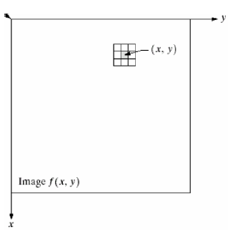
Spatial Filtering
Define a center point (x; y)
Perform an operation that involves only the pixels in a predefined neighborhood
Result of the operation response of the process at that point
Repeat the process for every pixel in the image

Slide 17
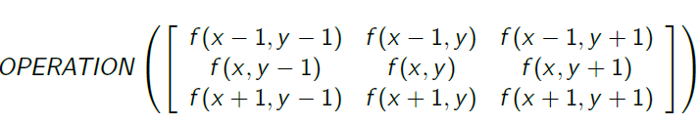
Spatial Filtering
Output is a function of a pixel value and its neighbours
Possible operations are: sum, weighted sum, average, weighted average, min, max, median,...
Example: 3X3 neighbourhood

Slide 18
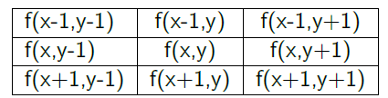
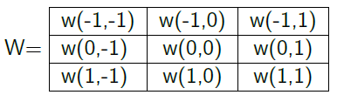

Local neighbourhood and kernel (mask)- correlation
The most common neighbourhood operation is to multiply each of the pixels in the neighbourhood by a weight and add them together
The local weights are sometimes called a mask or kernel

Slide 19
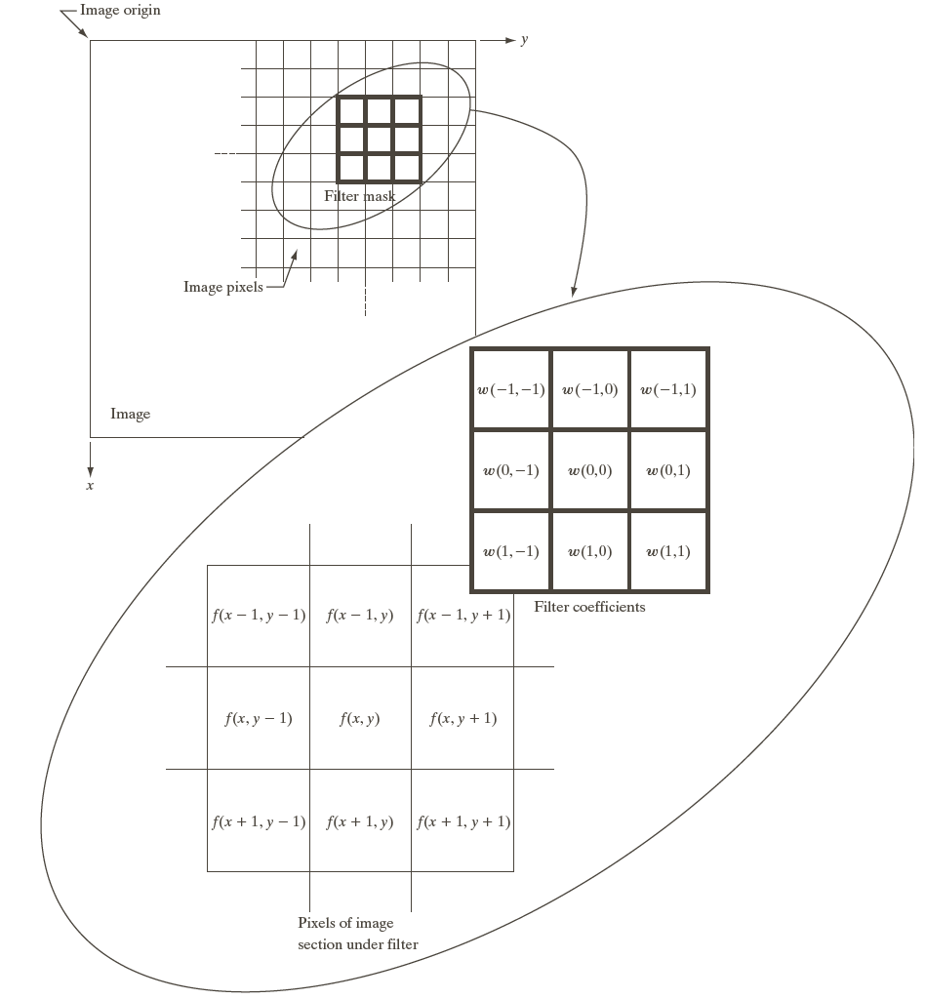
The mechanics of Spatial Filtering
The mechanics of spatial filtering

Slide 20
Why local neighbourhood?
Pixels in the neighbourhood are correlated
Rectangular neighbourhoods are often used with an odd number of pixels in rows and columns, enabling specification of the central pixel of the neighbourhood
Different neighbourhood sizes: 3X3, 5X5 ...,2n+1 X 2m+1

Slide 21
What happens to the image border?
Ignoring the pixels at the border
Adding artificial pixels outside the border
  Constant value { 0, 255, or some other value}
  Changing the size of the filter mask at the border

Slide 22
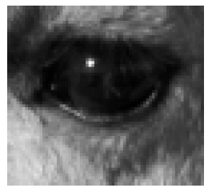
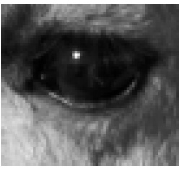
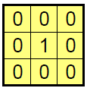
What Does This Filter Do?
Identity function (leaves image alone)

Slide 23
Spatial filtering
Linear filters:
  Smoothing filters
    Mean filter (Lab Assignment using Python )
    Gaussian filter (Lab Assignment using Python )
  Edge enhancing filters
    Sobel filter
    Prewitt filter
    Laplace filter
Non-linear filters:
  Min, Max (Lab Assignment using Python )
  Median (Lab Assignment using Python )

Slide 24
Smoothing filters
Referred to low-pass filters
Reduce sharp transition in intensities
Reduce noise
Reduce "irrelevant" details in the image
Blur edges

Slide 25
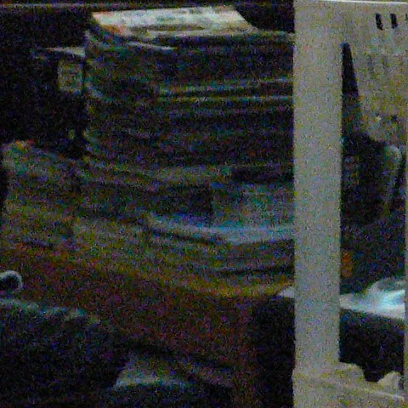
Image noise
Image noise is random (not present in the object imaged) variation of brightness or color information in images, and is usually an aspect of electronic noise. It can be produced by the sensor and circuitry of a scanner or digital camera.

Slide 26
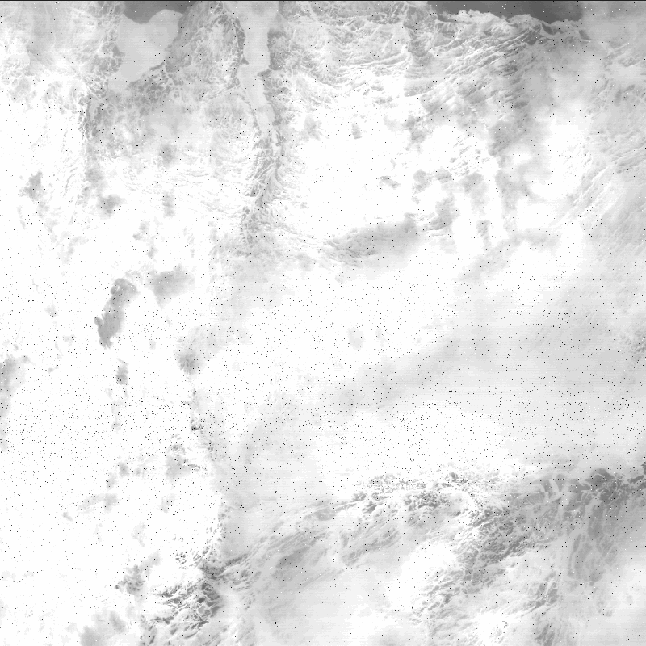
Noise problem
What kind of noise?
  Additive
  Multiplicative
  Impulsive
    i.e. salt and pepper
Image smoothing suppresses the noise by using the redundancy in the image data

Slide 27
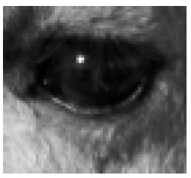
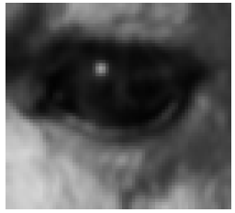
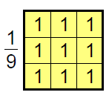
What Does This Filter Do?
Mean (averages neighborhood)

Slide 28
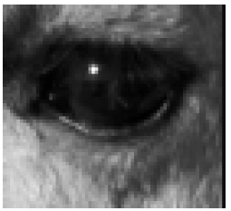
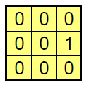
What Does This Filter Do?
Shift left by one pixel

Slide 29
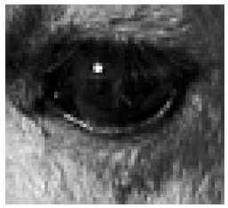
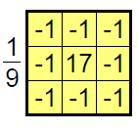
What Does This Filter Do?
Sharpen (identity minus mean filter)

Slide 30
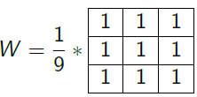
Mean filter
Replace each pixel with the average of itself and its neighbours
The kernel W contains only 1s
The result is divided by the sum of the weights, i.e., with 1/9
3X3 kernel
Fast operation for small neighbourhoods
Differing pixel values will become more like their neighbours:
  Noise is reduced
  Sharp edges are blurred

Slide 31
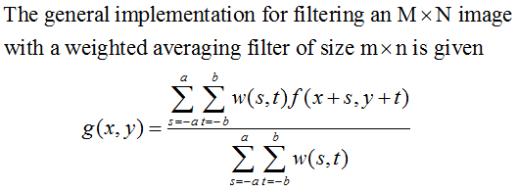
Spatial Smoothing Linear Filters

Slide 32
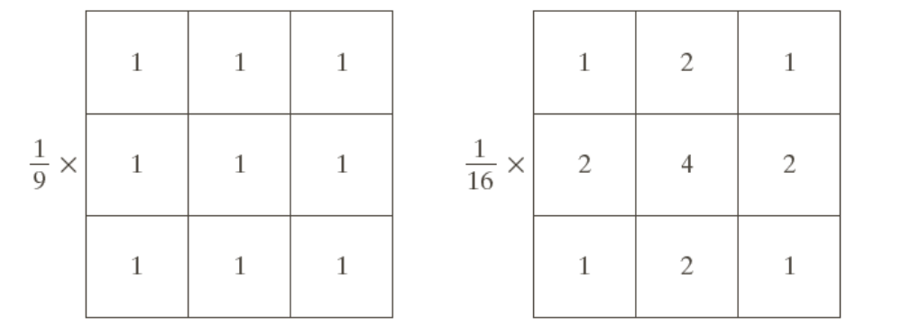
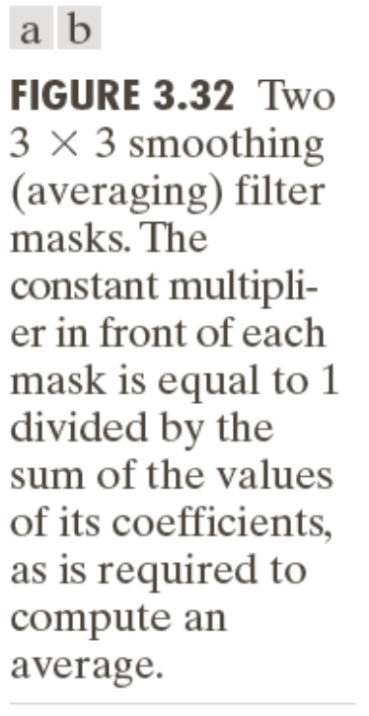
Two Smoothing Averaging Filter Masks

Slide 33
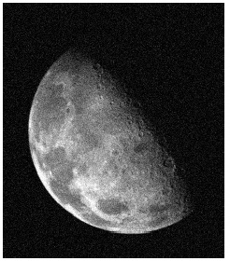
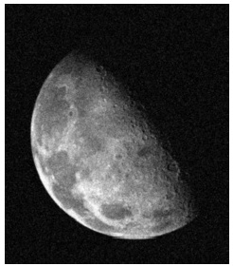
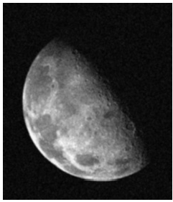
Mean filter- Example 1
Input image
Mean image with
3X3 kernel
Mean filter with 5X5
kernel

Slide 34
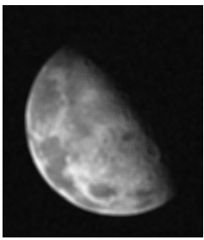
Mean filter- Example 2
Input image
Mean image with
3X3 kernel
Mean filter with 11X11
kernel

Slide 35
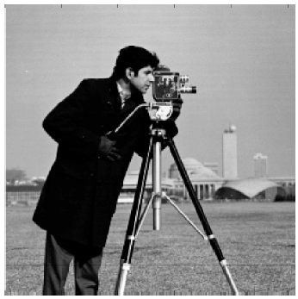
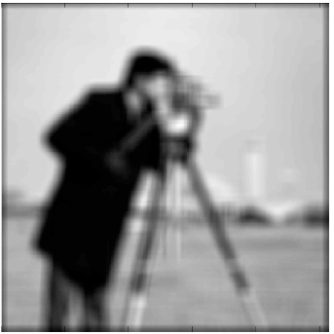
Mean filter- Example 2
Input image
Averaging image
11x11 box filter
Drawback: smoothing reduces fine image detail

Slide 36
The end

